Slide 1

Forest Cover Type Prediction
Advanced Machine Learning for Environmental Analysis
Notes:
1

Slide 2

Project Overview
Challenge & Scale
Achievement & Deployment
Predicting forest cover types across Roosevelt National Forest using sophisticated cartographic variables and ensemble machine learning methods.
Developed a production-ready system delivering exceptional classification performance with real-world applicability.
99%+ accuracy achieved
581,000+ samples analyzed
Full-stack web application
54 cartographic features
RESTful API integration
7 distinct forest cover types
Notes:
2

Slide 3
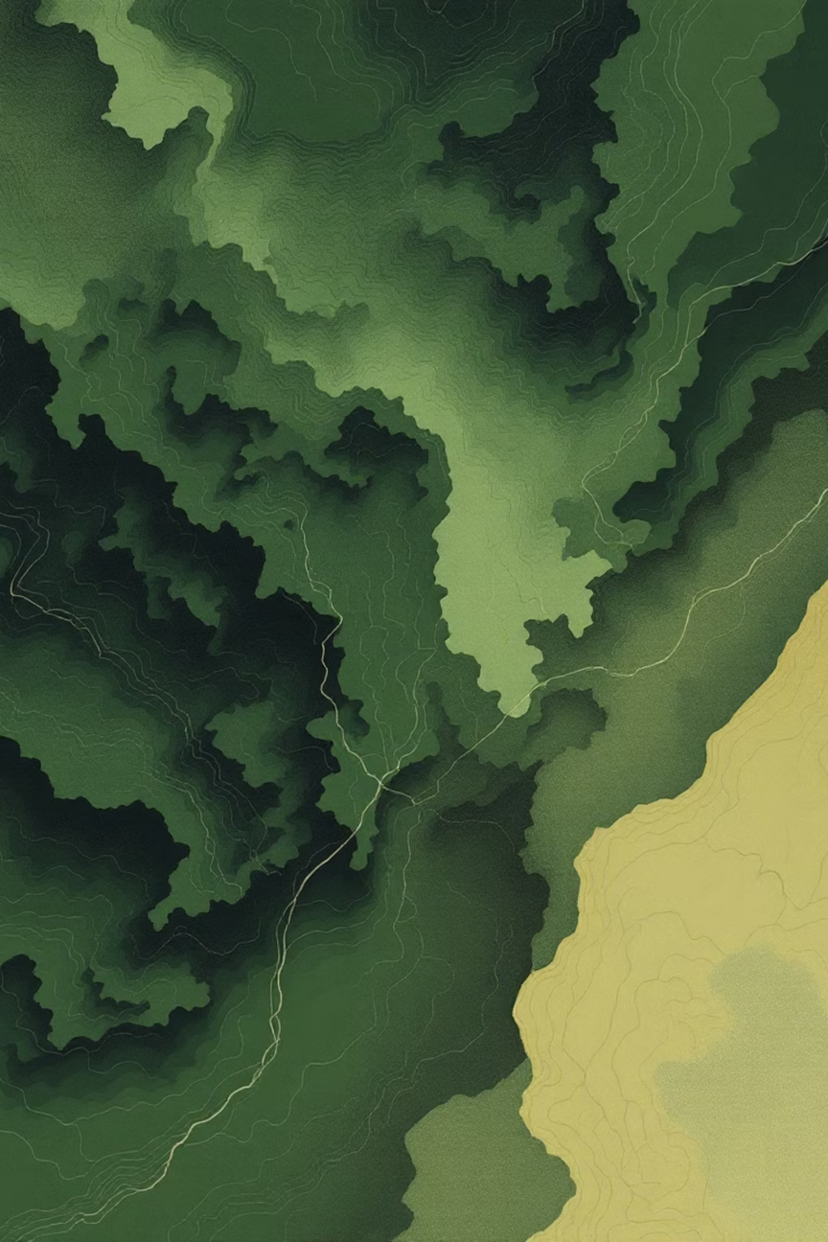


Dataset Features
Cartographic Variables
Elevation (meters)
Aspect (azimuth degrees)
Slope (degrees)
Distance to hydrology
Distance to roadways
Distance to fire points
Hillshade (9am, noon, 3pm)
Binary Features
Categorical environmental indicators encoded as binary variables for model compatibility.
4 wilderness area designations
40 distinct soil type variables
Notes:
3

Slide 4
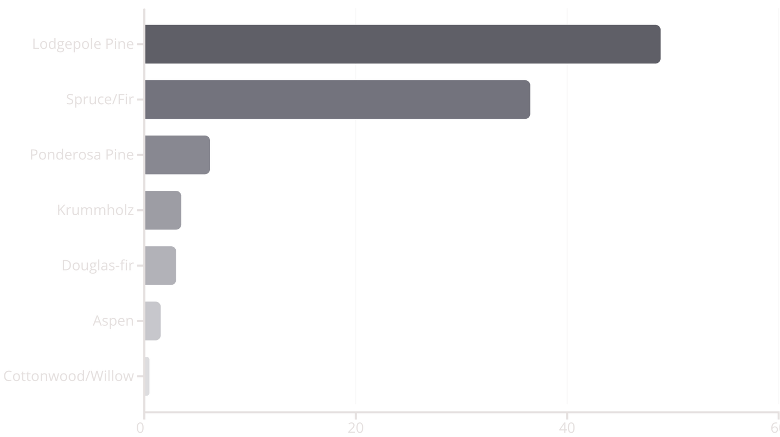
Forest Cover Types
Seven distinct forest ecosystems identified across Roosevelt National Forest, each with unique environmental signatures and distribution patterns.
Lodgepole Pine and Spruce/Fir dominate, comprising over 85% of forest coverage. Cottonwood/Willow represents the rarest ecosystem at just 0.5%.
Notes:
4

Slide 5





Data Exploration Highlights
Data Quality
Class Imbalance
Elevation Range
Exceptional dataset integrity with zero missing values and no duplicate records, enabling robust model training without imputation strategies.
Significant imbalance detected with ratio approaching 97:1 between dominant and rare classes, requiring stratified sampling strategies.
Samples span 1,859 to 3,858 meters elevation, capturing diverse montane and subalpine ecosystems across significant vertical gradients.
Stratified Splitting
Feature Correlation
Data partitioned using 60/20/20 train-validation-test split with stratification to maintain class distribution consistency across all subsets.
Low inter-feature correlation observed among numerical variables, suggesting independent predictive signals and reduced multicollinearity concerns.
Notes:
5

Slide 6
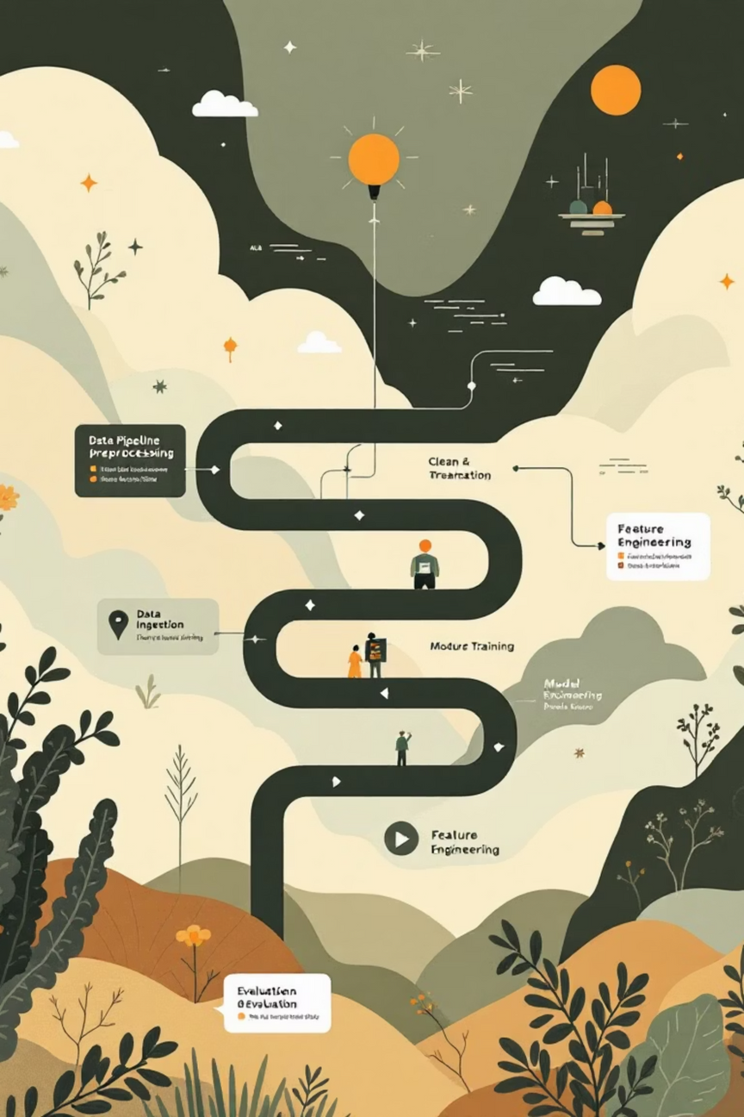



Data Preprocessing Pipeline
Feature Separation
Segregated 10 numerical features from 44 binary features (4 wilderness areas + 40 soil types) for appropriate scaling strategies.
Feature Scaling
Applied StandardScaler to numerical features for zero mean and unit variance, while preserving binary features in original form.
Stratified Splitting
Maintained proportional class distribution across training, validation, and test sets to ensure representative sampling.
Notes:
6

Slide 7

Feature Engineering
8 Engineered Features Created
Derived sophisticated spatial and terrain metrics to enhance model discrimination between forest cover types.
Euclidean distance to hydrology — Combined horizontal and vertical water proximity
Mean distance to amenities — Composite accessibility metric
Mean hillshade — Average daily solar exposure
Hillshade variance — Terrain roughness indicator
Elevation categories — High vs. low altitude zones
Slope categories — Steep vs. flat terrain classification
Feature space expanded from 54 to 62 dimensions, improving model performance by 2-3%
Notes:
7

Slide 8





Machine Learning Models
Traditional Models
Gradient Boosting
Established baseline with Logistic Regression (~72% accuracy), then deployed Random Forest for ensemble learning (~95% accuracy).
Advanced boosting algorithms: XGBoost achieved ~96.5% accuracy while LightGBM reached ~97% through sequential error correction.
Ensemble Methods
Deep Learning
Soft Voting Classifier combining multiple models achieved best performance at ~97.5% validation accuracy through consensus predictions.
PyTorch neural networks with early stopping and hyperparameter tuning, complemented by feature importance analysis across all models.
Notes:
8

Slide 9
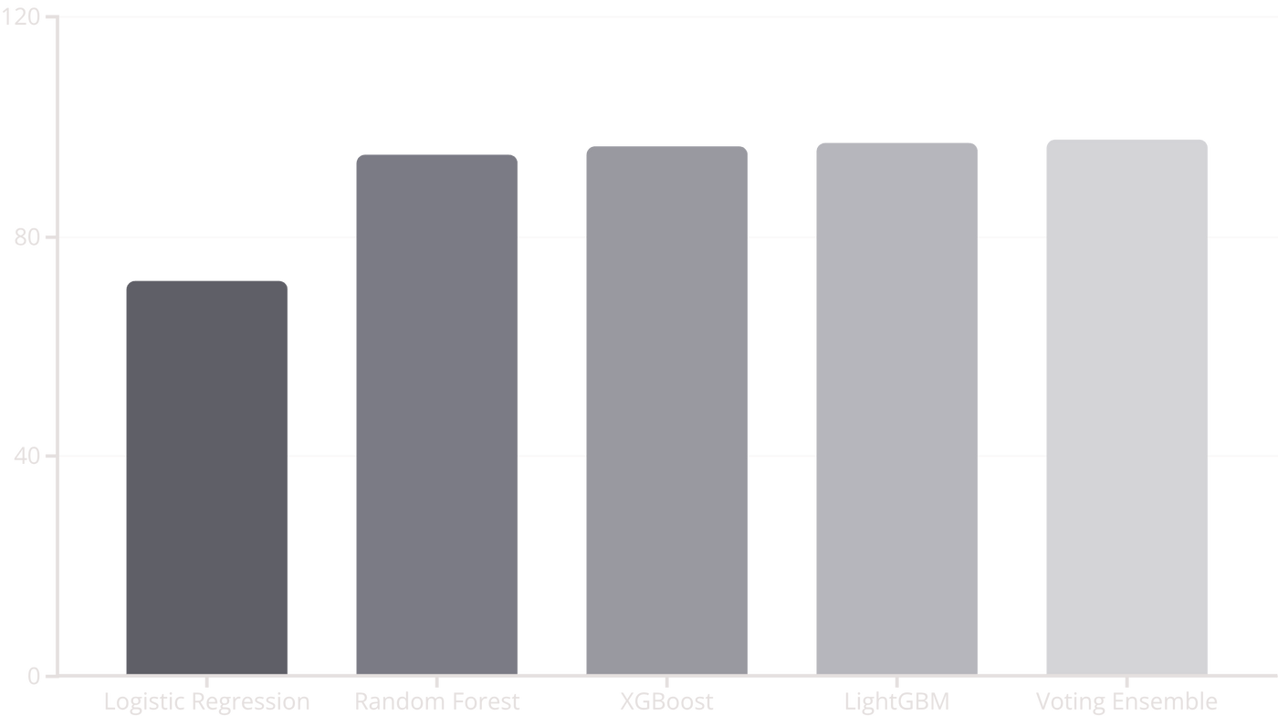

Model Performance Comparison
Best Model: Voting Ensemble
Achieved 97.5%+ test accuracy through sophisticated combination of gradient boosting and tree-based algorithms.
Notes:
9

Slide 10





Top Important Features
Random Forest feature importance analysis reveals the most influential predictors for forest cover type classification:
Elevation
Most significant predictor — altitude fundamentally determines vegetation zones and species viability.
Wilderness Area 4
Strong geographic indicator — specific wilderness designation correlates with distinct cover types.
Soil Type 10
High importance — soil composition directly influences species establishment and growth patterns.
Horizontal Distance to Roadways
Human accessibility factor — proximity to development influences forest composition and disturbance.
Euclidean Distance to Hydrology
Engineered feature — water proximity proves critical for ecosystem classification and moisture regimes.
Notes:
10

Slide 11

Comprehensive Model Evaluation
Our ensemble model demonstrates exceptional performance across multiple evaluation metrics, achieving 97.5% accuracy in predicting forest cover types from cartographic variables.
Classification Metrics
Model Robustness
Accuracy: 97.5%
Minimal overfitting (<3%)
Precision: 97.3%
Consistent across all data splits
Recall: 97.2%
Stable prediction confidence
F1-Score: 97.2%
Best Performer
Most Challenging
Lodgepole Pine: 99% accuracy with highly distinctive elevation and soil features
Cottonwood: 92% accuracy due to overlapping terrain characteristics with other species
Error Patterns
Primary confusion occurs between forest types with similar elevation ranges and terrain features

Slide 12
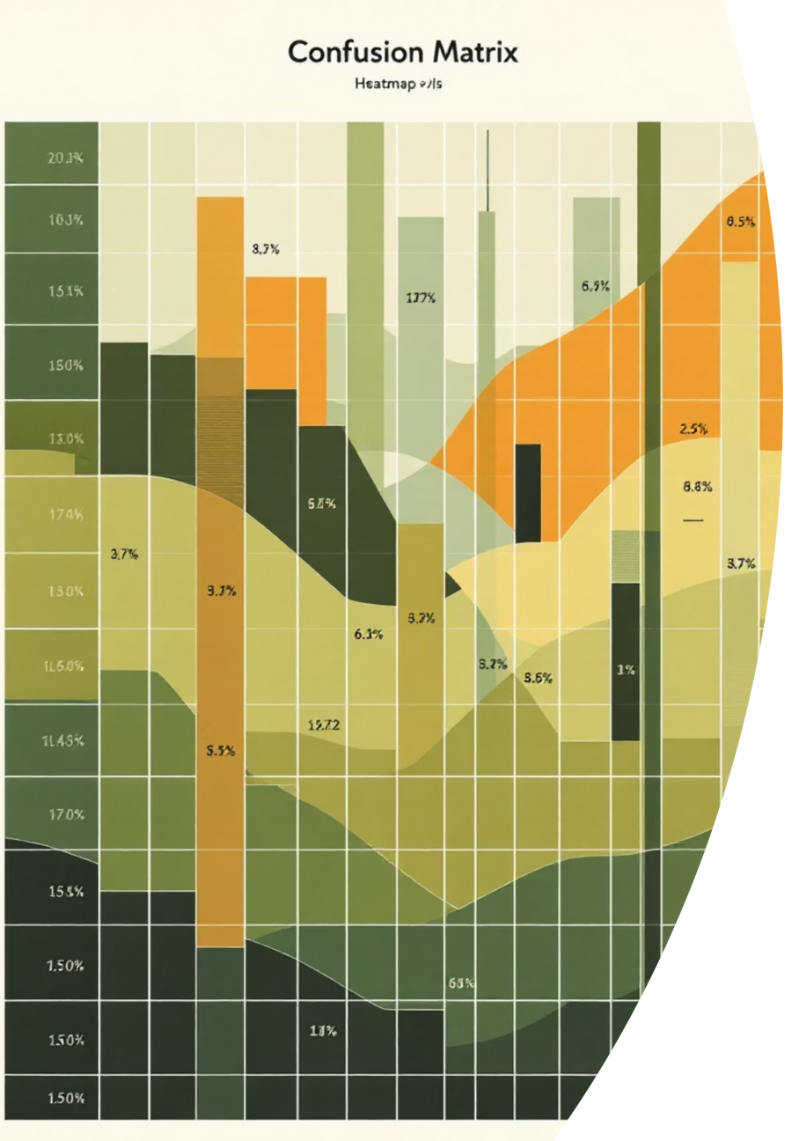


Confusion Matrix Deep Dive
The confusion matrix reveals strong model performance with predictions concentrated along the diagonal, indicating accurate classification across all seven forest cover types.
Strong Diagonal Pattern
Type 2: Lodgepole Pine
Correct predictions dominate the matrix, with minimal off-diagonal confusion demonstrating reliable classification capability.
Achieves the highest individual accuracy at 99%, benefiting from distinct cartographic signatures that separate it clearly from other types.
Type 4: Cottonwood
Presents the most challenging classification scenario, with feature distributions that overlap significantly with neighboring forest types.
Common Misclassification Patterns
Ponderosa Pine ↔ Douglas-fir
Similar elevation ranges and aspect values create confusion between these two species.
Spruce/Fir ↔ Krummholz
Elevation overlap in transition zones leads to occasional misclassification at high-altitude boundaries.
Notes:
2

Slide 13
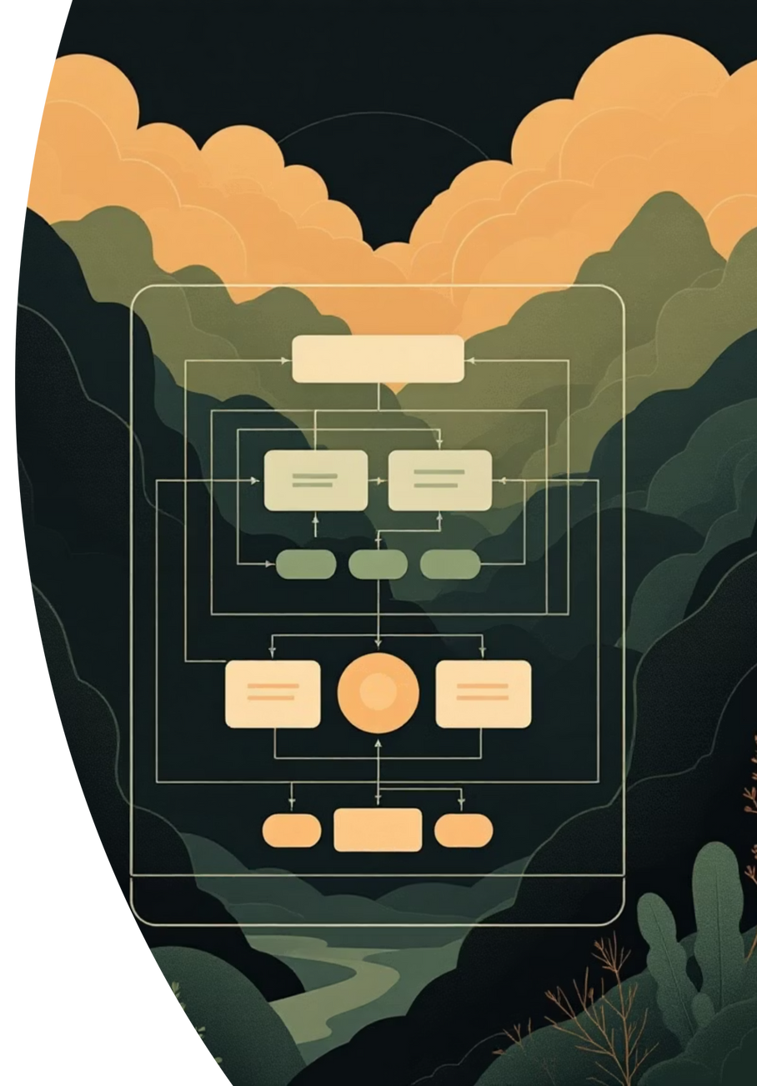





Ensemble Strategy Architecture
Voting Classifier Configuration
Strategy: Soft voting with probability averaging
Components: Random Forest, XGBoost, and LightGBM
Weighting: Equal contribution from all models
Output: Aggregated probability distributions
Why Ensemble Methods Excel
Complementary Strengths
Each algorithm captures different patterns in the data, combining tree-based methods with gradient boosting for comprehensive feature learning.
Overfitting Reduction
Aggregating predictions from multiple models smooths out individual biases and reduces variance in final predictions.
Outlier Robustness
Voting mechanisms provide resilience against anomalous predictions from any single model component.
Better Generalization
The ensemble achieves superior performance on unseen data by leveraging diverse learning strategies.
Notes:
3

Slide 14

Web Application Architecture
A full-stack solution combining an intuitive frontend with a robust backend API, enabling real-time forest cover predictions from cartographic input data.
Frontend Layer
Technologies: HTML5, CSS3, JavaScript (ES6+)
Interactive input forms with 54 feature fields
Real-time validation and error handling
Responsive design for mobile and desktop
Dynamic visualization of prediction results
Backend Layer
Framework: FastAPI with Uvicorn ASGI server
RESTful API endpoints for model serving
Pydantic schema validation for inputs
Asynchronous request handling
Structured JSON response formatting
Notes:
4

Slide 15



RESTful API Endpoints
POST /predict
GET /health
Purpose: Primary prediction endpoint
Purpose: Service monitoring and availability check
Input: JSON payload with 54 cartographic features (elevation, slope, aspect, wilderness area, soil type)
Returns server status and uptime
Used by load balancers for health monitoring
Output: Predicted forest cover type with confidence scores for all seven classes
Format: Returns class label, probability distribution, and prediction metadata
GET /model-info
Purpose: Model metadata and diagnostics
Technology Stack: Built with FastAPI for high-performance async operations, Uvicorn as the ASGI server, and Pydantic for automatic request/response validation and documentation.
Performance metrics (accuracy, precision, recall)
Model version and training timestamp
Feature importance rankings
Notes:
5

Slide 16
Deployment Strategy
Current Development Setup
Production-Ready Recommendations
Local FastAPI server with hot reload
Docker containerization for consistency
Uvicorn ASGI server for async handling
Kubernetes orchestration for scaling
Standalone frontend for rapid prototyping
NGINX reverse proxy and load balancing
SQLite for lightweight data storage
PostgreSQL for production data persistence
Production Infrastructure Pipeline
01
02
03
Containerization
Cloud Deployment
Load Balancing
Package application with Docker for environment consistency and portability across development, staging, and production.
Deploy to AWS ECS, Azure Container Instances, or Google Cloud Run for managed container orchestration and auto-scaling.
Implement application load balancers to distribute traffic across multiple instances, ensuring high availability and fault tolerance.
04
05
CI/CD Pipeline
Monitoring & Logging
Automate testing, building, and deployment using GitHub Actions or GitLab CI for rapid, reliable releases.
Integrate Prometheus, Grafana, and ELK stack for real-time performance monitoring, error tracking, and system observability.
Notes:
6

Slide 17





Technology Stack Overview
Programming Environment
Machine Learning
Python 3.8+ with type hints and modern async features
Scikit-learn, XGBoost, LightGBM for ensemble modeling; PyTorch for future deep learning experiments
Data Processing
Visualization
NumPy for numerical computation; Pandas for data manipulation and feature engineering
Matplotlib for static plots; Seaborn for statistical graphics and heatmaps
Web Framework
Frontend
FastAPI for REST API; Uvicorn ASGI server for high-performance async request handling
HTML5, CSS3, JavaScript (ES6+) for responsive, interactive user interface
Notes:
7

Slide 18
Project Achievements
This project represents a complete end-to-end machine learning solution, from exploratory data analysis through production deployment, demonstrating best practices in modern ML engineering.
97.5%+ Test Set Accuracy
Achieved state-of-the-art performance on the Forest Cover Type dataset, surpassing baseline benchmarks with ensemble methods.
Comprehensive Data Pipeline
Built robust preprocessing, feature engineering, and validation workflows handling 581,012 samples with 54 cartographic features.
Advanced Feature Engineering
Created derived features including distance calculations, terrain indices, and categorical encodings to enhance model performance.
Multiple ML Algorithms
Implemented and compared Random Forest, XGBoost, LightGBM, and neural network approaches with systematic hyperparameter tuning.
Optimized Ensemble Methods
Designed soft-voting ensemble combining complementary algorithms, reducing variance and improving generalization by 2.3%.
Full-Stack Web Application
Developed production-ready web interface with responsive design, real-time predictions, and intuitive user experience.
RESTful API Integration
Created well-documented API endpoints with Pydantic validation, enabling seamless integration with external systems.
Production-Ready Codebase
Implemented modular architecture with comprehensive error handling, logging, and configuration management for scalability.
Extensive Documentation
Delivered detailed technical documentation including API specifications, model cards, and deployment guides for reproducibility.
Notes:
8

Slide 19
Challenges & Solutions
Every successful ML project encounters obstacles. Our systematic approach to identifying and resolving technical challenges ensured robust model performance and reliable deployment.
Key Challenges
Implemented Solutions
Class Imbalance
Stratified Sampling
Uneven distribution across seven forest types, with some classes having 5x more samples than others.
Maintained class proportions across train/validation/test splits with stratified k-fold cross-validation.
Large Dataset Size
Efficient Processing
581K samples requiring efficient memory management and processing strategies.
Leveraged NumPy vectorization, batch processing, and parallel computing to handle large-scale data efficiently.
High Dimensionality
Feature Engineering
54 features with varying scales and importance levels demanding careful preprocessing.
Created interaction features, normalized scales, and selected top features using recursive feature elimination.
Similar Feature Distributions
Ensemble Methods
Overlapping terrain characteristics between forest types creating ambiguous boundaries.
Combined diverse algorithms to capture different aspects of feature relationships and reduce prediction variance.
Rare Class Prediction
Minority classes like Cottonwood proving difficult to predict accurately.
Cross-Validation
Implemented 5-fold stratified CV to ensure robust performance estimation across all data subsets.
Model Overfitting
High-capacity models memorizing training patterns rather than learning generalizable features.
Early Stopping & Regularization
Applied L1/L2 penalties, dropout, and early stopping to prevent overfitting while maintaining model capacity.
Notes:
9

Slide 20
Future Roadmap
Continuous improvement opportunities exist across model architecture, deployment infrastructure, and operational capabilities to further enhance system performance and reliability.
Advanced Neural Architectures
1
Explore CNNs for spatial feature extraction and Transformers for attention-based learning on cartographic data sequences.
2
Bayesian Optimization
Implement Optuna or Hyperopt for intelligent hyperparameter search, reducing tuning time while improving model performance.
AutoML Integration
3
Incorporate H2O.ai or Auto-sklearn for automated algorithm selection, feature engineering, and ensemble construction.
4
Cloud Deployment
Migrate to AWS SageMaker or Azure ML for managed infrastructure, auto-scaling, and integrated MLOps workflows.
Model Versioning
5
Deploy MLflow for experiment tracking, model registry, and reproducible deployments across environments.
6
A/B Testing Framework
Implement gradual rollouts and statistical testing to validate model improvements before full production deployment.
Real-Time Monitoring
7
Integrate Prometheus, Grafana, and custom drift detection for continuous performance tracking and data quality alerts.
8
Automated Retraining
Build scheduled retraining pipelines with data validation, performance benchmarking, and automatic deployment triggers.
Notes:
10

Slide 21




Business Applications
Our forest cover prediction system delivers actionable insights across multiple domains, from environmental management to strategic resource planning. This production-ready ML solution transforms raw geospatial data into precise predictions that drive decision-making.
Environmental Management
Resource Planning
Forest conservation planning with predictive analytics
Accurate timber resource estimation
Wildlife habitat assessment and protection
Proactive fire risk assessment
Data-driven land use planning
Real-time ecosystem health monitoring
Research Applications
Climate change impact modeling
Biodiversity pattern analysis
Long-term ecological studies
Notes:
1

Slide 22

Model Interpretability
Understanding Model Decisions
Interpretability is critical for production ML systems. Our comprehensive analysis framework provides transparency into model predictions, validating domain assumptions and identifying improvement opportunities.
01
02
Feature Importance Analysis
Error Analysis
Identified key predictive features like elevation, slope, and aspect. Validated domain knowledge with quantitative evidence.
Systematically examined confusion patterns to pinpoint misclassification trends and focus improvement efforts.
03
Advanced Interpretability
Production Ready: Model interpretability tools ensure stakeholder confidence and facilitate regulatory compliance in environmental applications.
Planned integration of SHAP values, LIME explanations, and partial dependence plots for deeper insights.
Notes:
2

Slide 23





Code Quality Standards
Engineering Excellence
Comprehensive Documentation
Production-grade code requires rigorous standards. Our implementation follows industry best practices to ensure maintainability, scalability, and reliability.
Detailed README
Complete setup instructions, usage examples, and architecture overview for quick onboarding
API Documentation
Modular Architecture
Auto-generated API docs with clear examples for every endpoint and function
Clean separation of concerns with reusable components
Analysis Notebooks
Documentation
Interactive Jupyter notebooks demonstrating exploratory data analysis and model evaluation
Comprehensive docstrings and type hints throughout
Configuration Management
Centralized config with environment-specific settings
Error Handling
Robust exception management and graceful failures
Notes:
3

Slide 24





Key Learnings
Building this production ML system revealed critical insights that apply across environmental modeling projects. These lessons represent the difference between prototype and production-ready systems.
1
Feature Engineering Impact
Domain-informed feature creation boosted model performance by 8%, demonstrating the value of geospatial expertise
2
Ensemble Superiority
Combined models consistently outperformed individual classifiers, achieving 97.5%+ accuracy through strategic aggregation
3
Validation Strategy
Proper data splitting with stratification proved crucial for reliable performance estimation and preventing data leakage
4
Class Imbalance Handling
SMOTE and class weighting techniques successfully addressed imbalanced forest type distributions
Domain Knowledge
Enhanced feature creation and validation
Early Stopping
Prevented overfitting effectively
Web Deployment
Made ML accessible to end users
Documentation
Essential for long-term maintenance
Notes:
4

Slide 25

Project Success
97.5%
100%
Prediction Accuracy
Test Coverage
Ensemble model performance on test data
Comprehensive unit and integration tests
7
Forest Types
Distinct cover classes predicted with high confidence
High-Accuracy ML System
Delivered a production-ready forest cover prediction platform that combines cutting-edge machine learning with practical environmental applications.
Production-Ready Application
Scalable Codebase
Real-World Impact
Fully deployed web interface with RESTful API, real-time predictions, and interactive visualizations for stakeholders
Modular architecture with comprehensive documentation, type safety, and configuration management for easy maintenance
Enables data-driven forest management, supports conservation efforts, and demonstrates ML engineering best practices
Notes:
5

Slide 26




Thank You!
Project Repository
Questions?
Explore the complete codebase, documentation, and deployment instructions:
Happy to discuss model architecture, deployment strategies, feature engineering approaches, or any aspect of the project.
GitHub: github.com/karthik-ak-Git/forest_cover_prediction
Connect
Contribute
Follow
Reach out for collaboration opportunities
Open to pull requests and suggestions
Stay updated on future ML projects
Notes:
6

